Slide 1




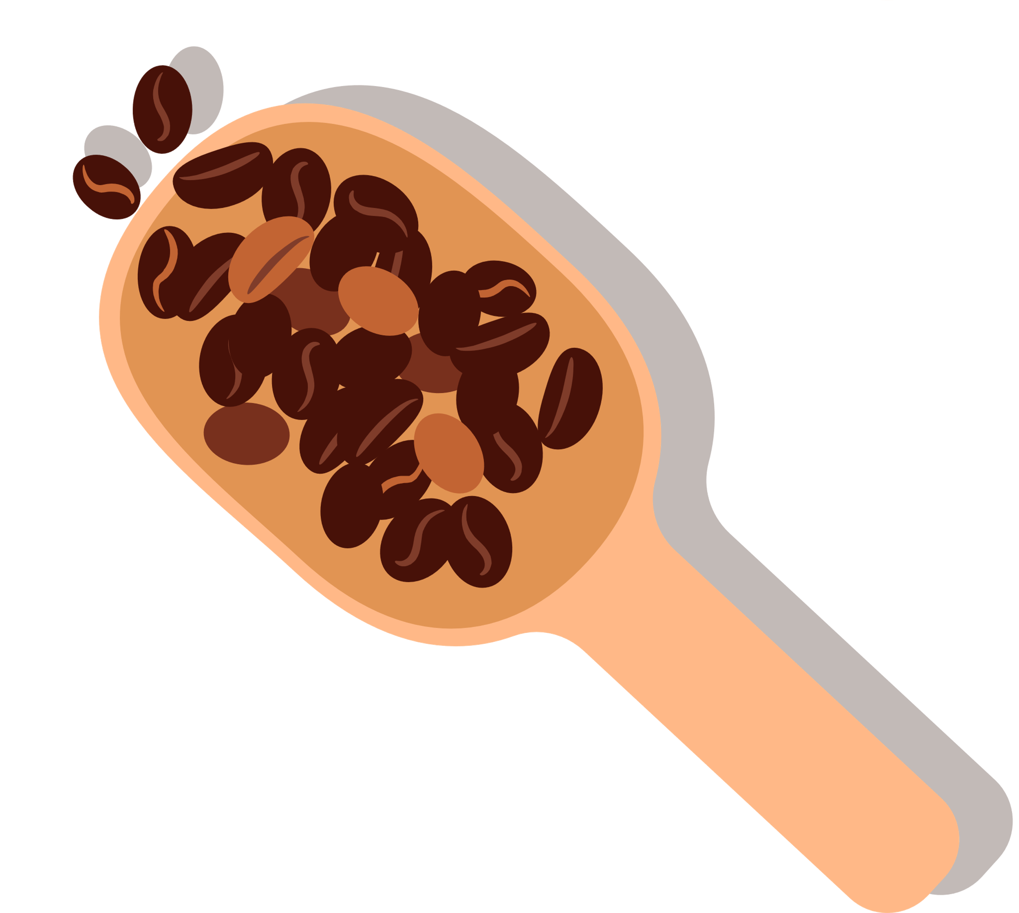



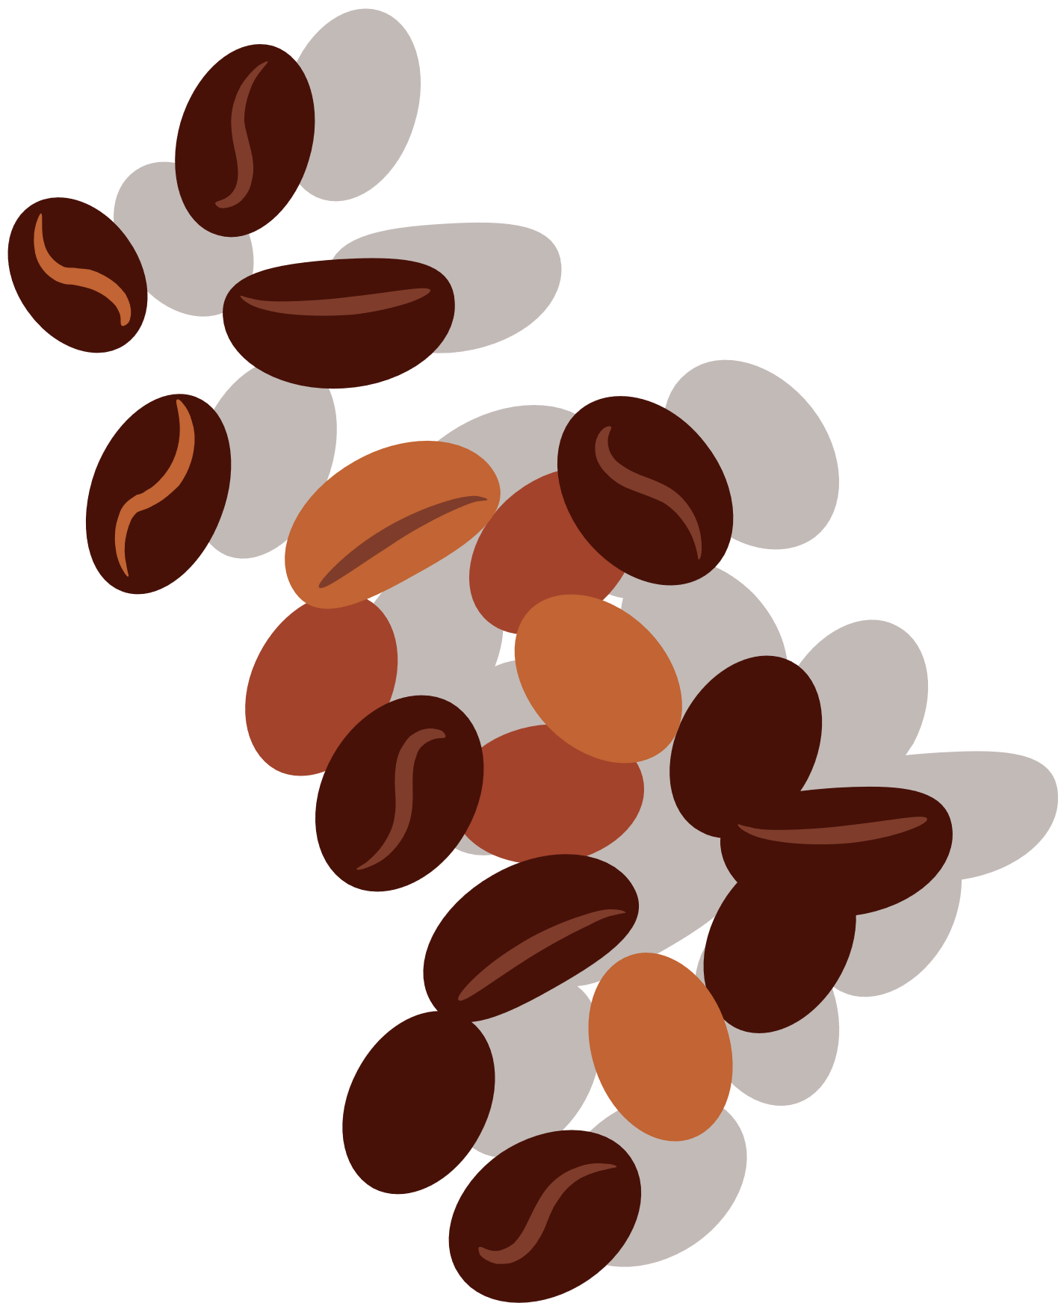

COFFEE DATASET
PROJECT IN PYTHON
PARTHASARATHI
DA-DS
MAY -BATCH

Slide 2
INTRODUCTION
Problem Statement/ Objective:
Coffee producers struggle to know which attributes define quality.
Aim: Discover key patterns and trends to support better grading and production decisions.
Project Overview:
Analysis of the Coffee Quality Dataset to identify factors affecting coffee quality.
Focus on sensory attributes like aroma, flavor, acidity, and body.
Use of data cleaning, analysis, and visualization for actionable insights.

Slide 3
2. DATA UNDERSTANDING
Quality Measures | Bean Metadata | Farm Metadata
Aroma Flavour Aftertaste AcidityBody Balance Uniformity Cup Cleanliness Sweetness Moisture Defects | Processing Method Colour Species (Arabica / Robusta) | Owner Country of Origin Farm Name Lot Number Mill Company Altitude Region

Slide 4
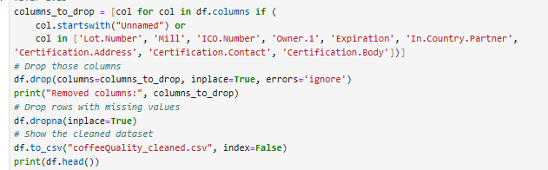
3. DATA CLEANING
Why Data Cleaning is Necessary:
Ensures accuracy and reliability of analysis.
Removes errors, inconsistencies, and missing values.
Improves data quality for better insights and decision-making.
.
High-Level Steps Taken:
Removed irrelevant or duplicate columns.
Handled missing and inconsistent values.
Standardized data formats (text, numbers, dates).
Verified data accuracy through validation checks

Slide 5
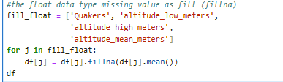
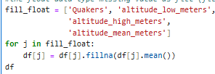
4. HANDLE MISSING VALUES
Identified missing data using:
Analyzed patterns of missing values.
df.isnull().sum()
Methods Used:
Deletion (for heavily missing data)
Mean/Median (numerical)
ffill and bfill (categorical)
Result: Clean dataset ready for analysis
EX:MEAN FILL
EX: FFILL AND BFILL

Slide 6
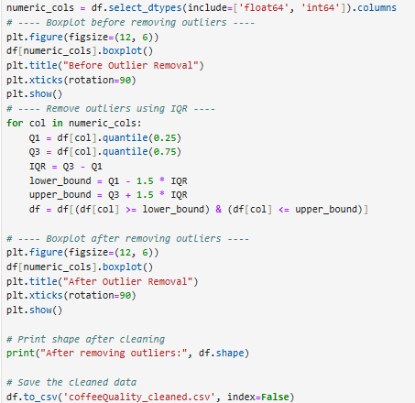
5. OUTLIER HANDLING
Identified outliers using boxplots and IQR method.
Removed data points outside 1.5 × IQR range.
Compared dataset shape before and after cleaning.
Result: More accurate and consistent dataset.
EX.OUTLIER

Slide 7
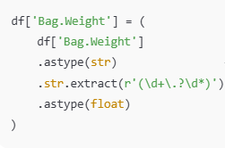

6. HANDLING INVALID VALUES
Cleaned Bag.Weight by extracting numeric parts and removing invalid text.
Corrected Number.of.Bags with median values and converted to Int64.
Validated altitude data; flagged negative or illogical ranges.
Result: Fixed incorrect entries and ensured consistent data types.
EX:REMOVE”KG”
EX:HANDLING MISSING

Slide 8
7. STATISTICAL ANALYSIS
ANOVA Test
Purpose:
Tested if Aroma scores differ across Processing Methods.
Method:
One-way ANOVA (f_oneway) comparing group means.
Interpretation:
p < 0.05: Processing methods have significantly different Aroma scores.
p ≥ 0.05: No significant difference found.
Visualization:
Boxplot of Aroma by Processing Method.
T-Test
Objective:
Compared Total Cup Points between Arabica and Robusta.
Method:
Independent two-sample t-test (ttest_ind).
Interpretation:
p < 0.05: Significant difference in mean scores.
p ≥ 0.05: No significant difference found.
Visualization:
Boxplot of Total Cup Points by Species

Slide 9

8. DESCRIPTIVE ANALYSIS
Explored dataset with df.info() to check structure and data types.
Summarized key statistics (mean, min, max, std, quartiles) using df.describe().
Checked missing values with df.isnull().sum().
Visualized distributions and outliers using histograms and boxplots.
EX:

Slide 10
9. RELATIONSHIP BETWEEN
VARIABLES
Chi-Square Test – Species vs Country of Origin
Objective:
Check if coffee Species distribution varies by Country of Origin.
Method:
Chi-Square Test of Independence (chi2_contingency) on contingency table.
Interpretation:
p < 0.05: Significant association found.
p ≥ 0.05: No significant relationship.
Visualization:
Heatmap of Species vs Country of Origin frequencies

Slide 11
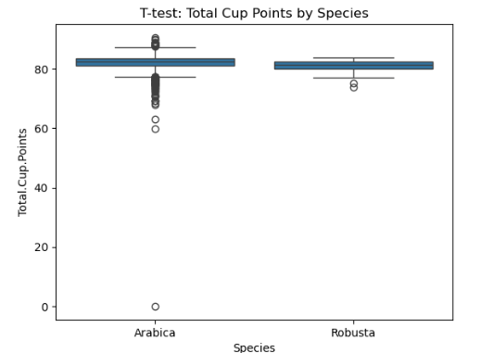
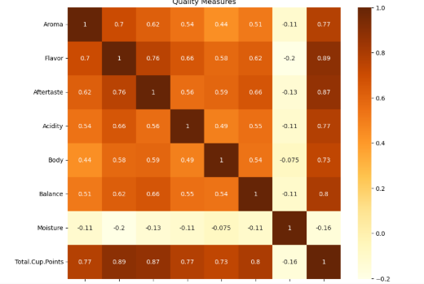
10. DATA VISUALIZATION
Highlights patterns, trends, and outliers in coffee data.
Makes analysis simple and supports better decisions.
Visuals used: Boxplots, Histograms, Heatmaps, Bar Charts.
Helped reveal quality trends and key influencing factors.

Slide 12
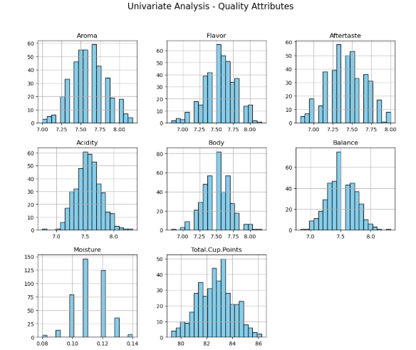
11. UNIVARIATE ANALYSIS
Explored individual quality attributes (Aroma, Flavor, Aftertaste, etc.).
Used histograms to show data distribution and boxplots for outlier detection.
Summarized mean, median, and spread with descriptive statistics.
Helped identify patterns and variations in coffee quality scores.

Slide 13
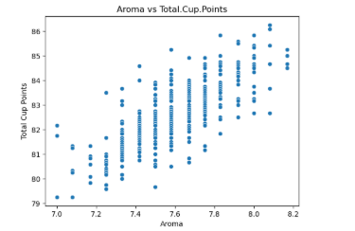
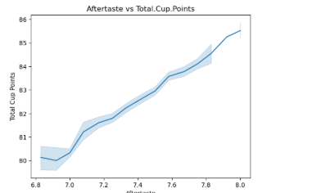
12. BIVARIATE ANALYSIS
scatter plots
Examined relationships between two variables (e.g., Aroma vs Total Cup Points).
Used scatter plots, bar plots, line plots, and pie charts for analysis.
Found positive links between Aroma, Acidity, and overall cup points.
Showed species and country distributions with pie charts
LINEPLOT

Slide 14
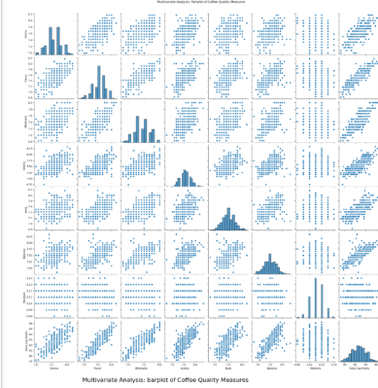
13. MULTIVARIATE ANALYSIS
PARIPLOT
Analyzed relationships among multiple quality measures.
Used correlation heatmaps and pairplots to find attribute interdependencies.
Discovered strong correlations between Aroma, Flavor, and Total Cup Points.
Compared quality measures across species with grouped bar plots

Slide 15
14. CONCLUSION
No significant difference in Total Cup Points between Arabica and Robusta (T-Test p > 0.05).
Processing method does not significantly affect Aroma scores (ANOVA p > 0.05).
Aroma, Flavor, and Balance remain the strongest drivers of cup score.
Geographic patterns: Arabica common in Ethiopia/Colombia, Robusta in Vietnam/Uganda.
Data cleaning improved reliability: missing values handled, weights standardized, outliers removed.

Slide 16
15. REMMENDATION
Focus on quality attributes – invest in aroma, flavor, and balance improvements.
Processing method optimization – further study environmental and farming factors.
Country-specific strategies – strengthen cultivation practices in dominant regions.
Data-driven decisions – maintain standardized datasets for accurate analysis.
Future research – explore altitude, soil, and climate impacts on cup scores

